Slide 1

TB 1300 – SAP Business One SDK Learn More About SAP Business One Extensibility
July, 2019
Notes:
Welcome to the Learn More About SAP Business One Extensibility course topic.

Slide 2

Community Page – SAP Business One Extensibility
In this community, we want to share important information and tips designed to help you take better advantage of SAP Business One Extensibility APIs and tools while also offering a communication channel for open discussions. Join the community!
https://www.sap.com/community/topics/business-one-extensibility.html
Notes:
SAP Business One Extensibility has a community page.
In this community, we want to share important information and tips designed to help you take better advantage of SAP Business One Extensibility APIs and tools while also offering a communication channel for open discussions.
Don’t forget to join the community!

Slide 3
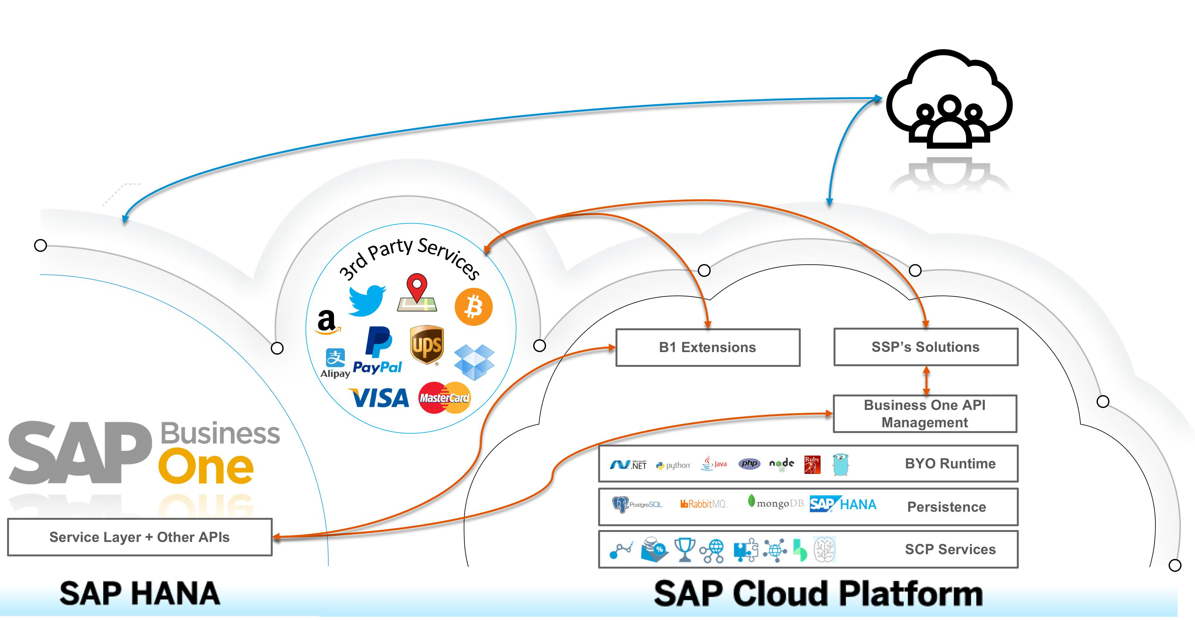
Blog Series – Loosely Coupled Solutions for SMB Topics
This is a compilation of all the articles, samples, and other relevant resources regarding loosely coupled solutions focused on small and midsize businesses.
https://blogs.sap.com/2018/06/05/loosely-coupled-solutions-for-smbs-topics/
Notes:
Please have a look at this blog series as well, where you can find a compilation of all the articles, samples, and other relevant resources regarding loosely coupled solutions focused on small and midsize businesses.

Slide 4

Blog Series – Topics Regarding SAP Business One, Version for SAP HANA Extensibility
Get a summary of the documents, blogs, and samples available to assist you in developing your solutions on top of the SAP Business One version for SAP HANA interfaces.
http://scn.sap.com/docs/DOC-60454
Notes:
Another very useful blog series has been published to support and improve development on top of the SAP Business One version for SAP HANA interfaces.

Slide 5
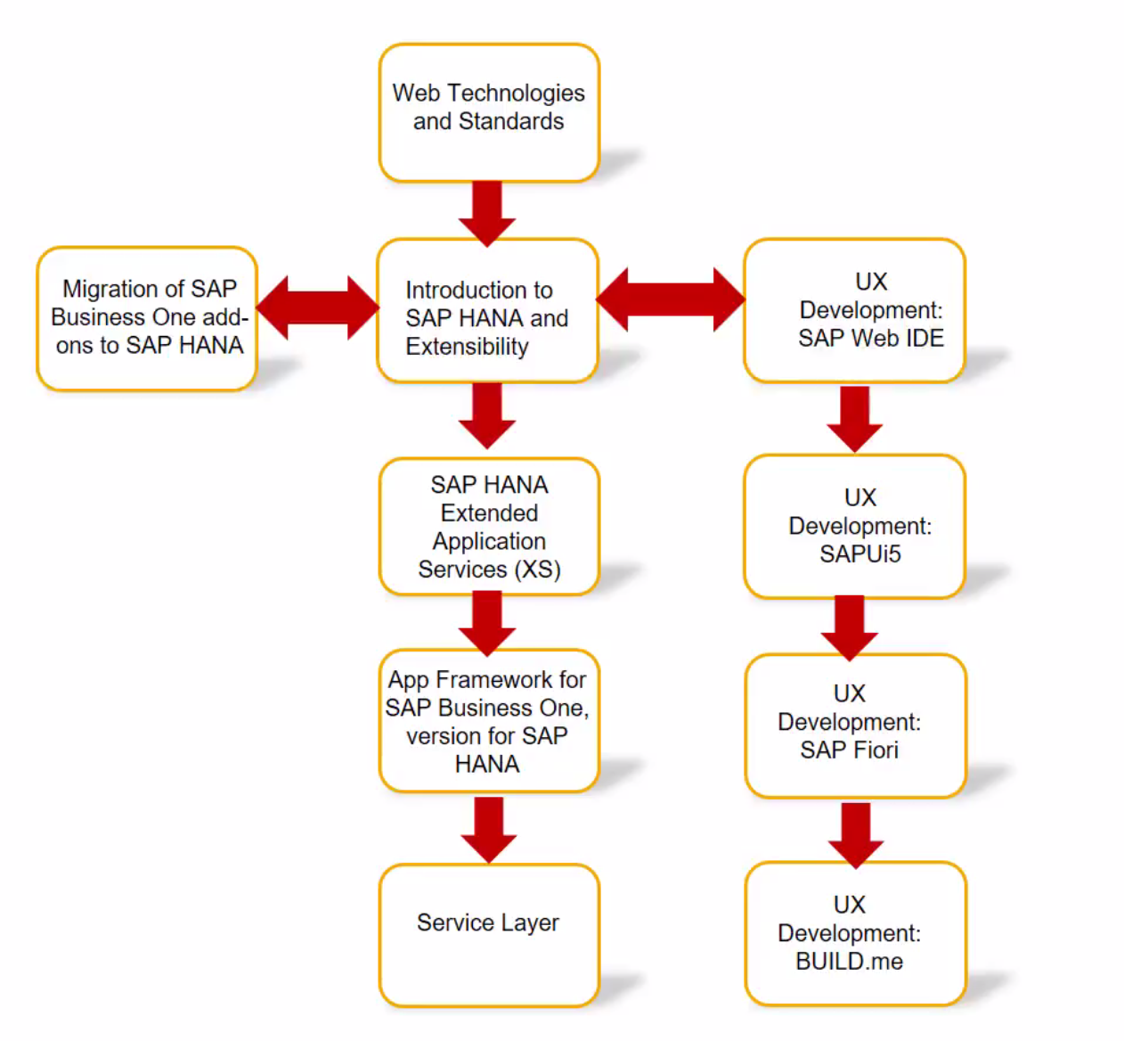
E-Learning: SAP Business One on HANA Development
Please refer to this blog:
https://blogs.sap.com/2017/10/19/sap-business-one-on-hana-development-e-learning-is-live/
The course is published on the SAP Learning Hub (direct link) and YouTube.
Notes:
The e-learning course SAP Business One on HANA Development has been published as a YouTube playlist. To access the playlist, please visit the blog provided.
The same training is available on SAP Learning Hub, as well.

Slide 6
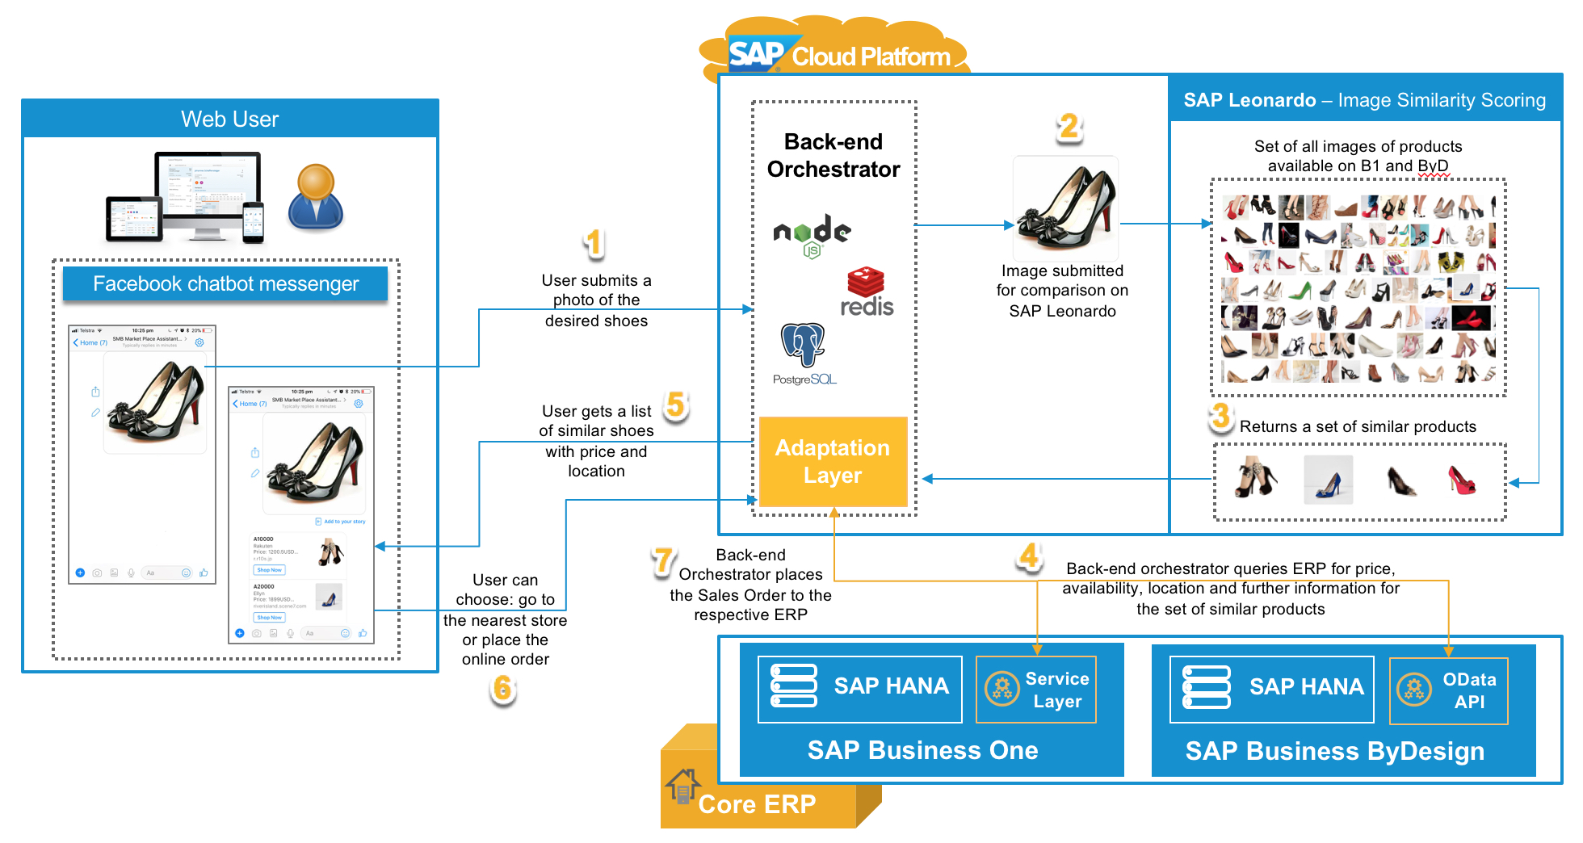
Digital Transformation for SMBs – the Intelligent Enterprise
SMB Market Place Assistant Bot
We have developed a proof-of-concept that shows these concepts and illustrates how easy it is to take advantage of business services, intelligent solutions, and the interchangeability of the underlying digital cores.
Please refer to this blog and video.
Notes:
SAP provides a very interesting proof-of-concept of SMB Market Place Assistant Bot.
It can show you how easily the business service can be used, how to build an intelligent solution, and how to leverage the interchangeability of the underlying digital cores.

Slide 7
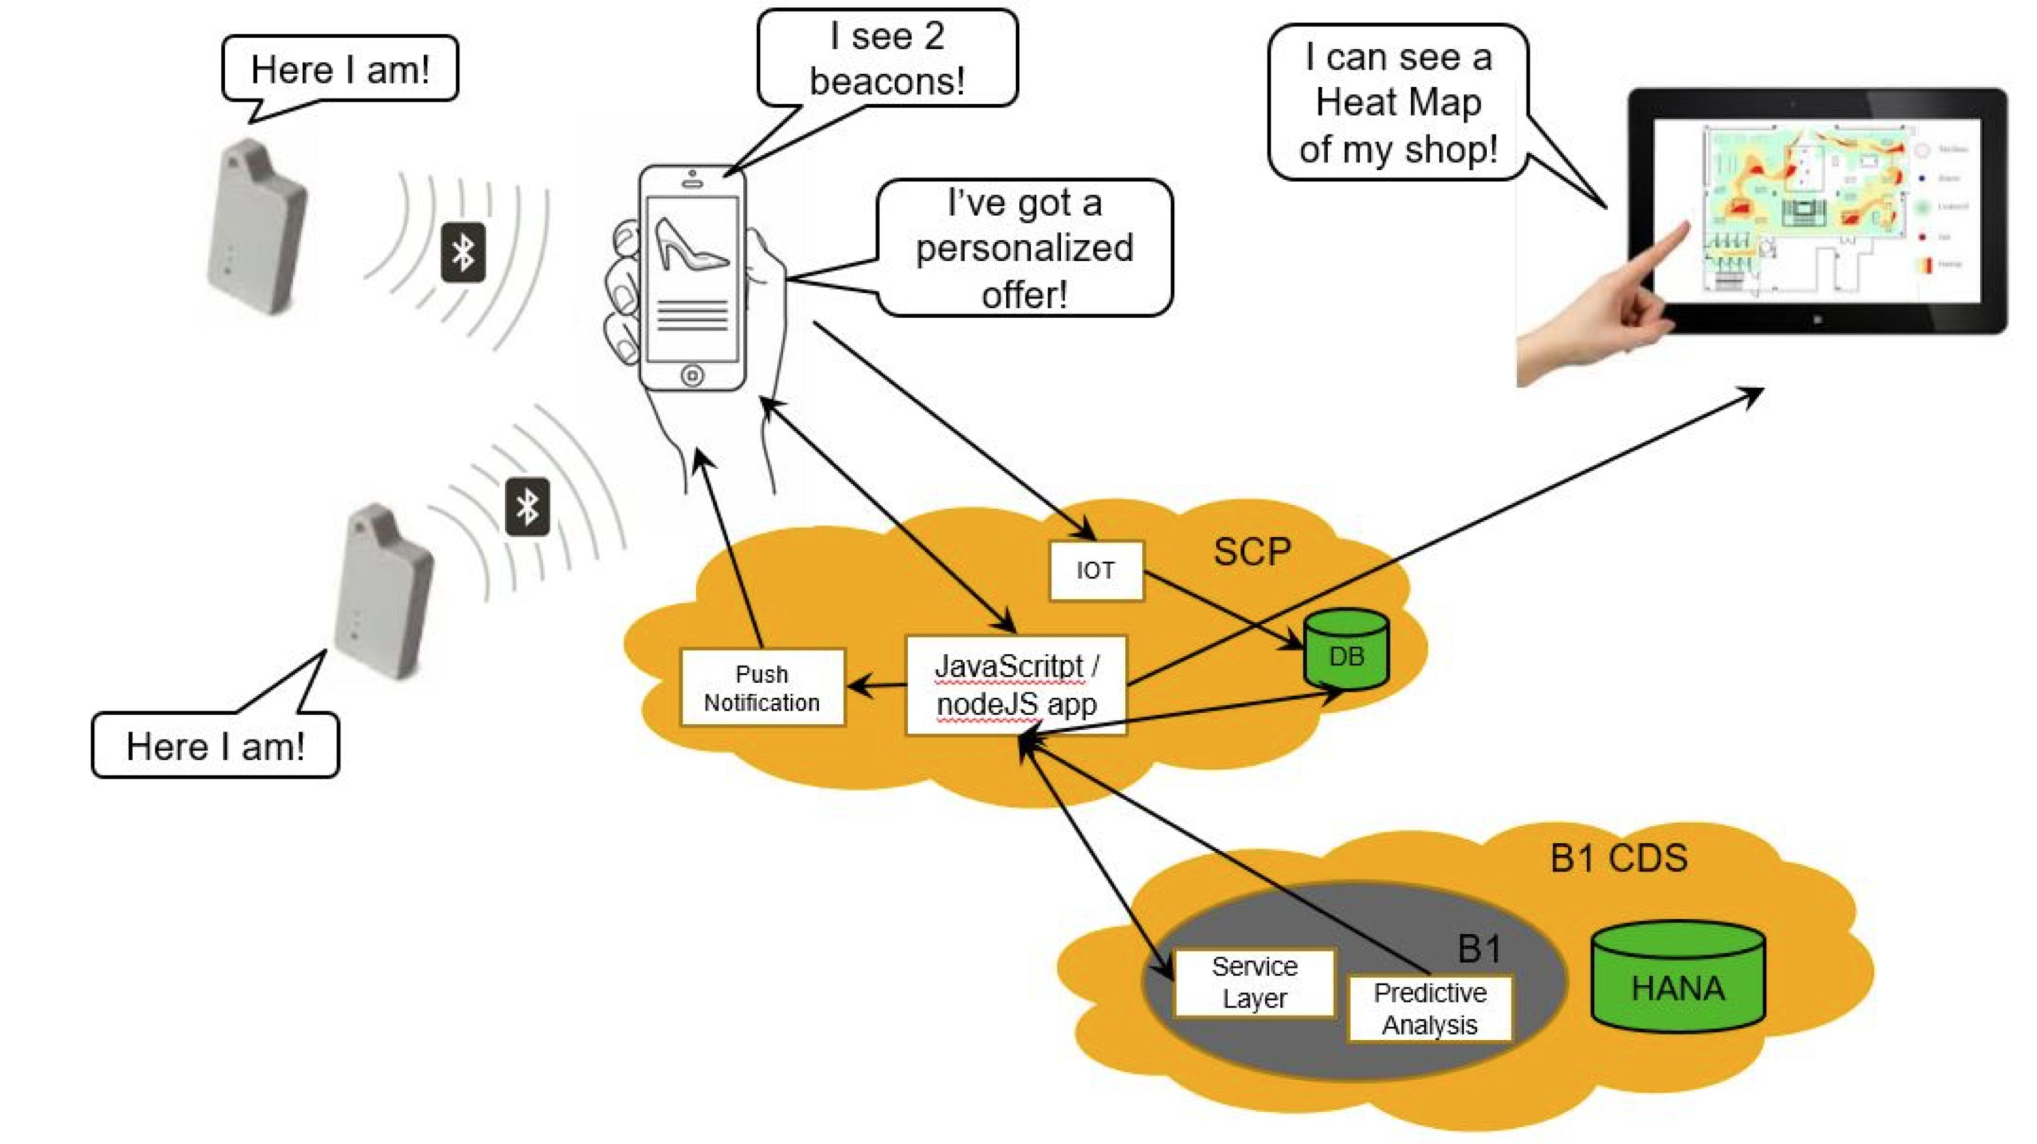
A Smart Shop with IoT, B1, and SAP Cloud Platform
BeaconsOne
Please refer to this blog and video.
Notes:
Another interesting proof-of-concept is based on smart shop requirements and the integration of SAP Business One business data and beacon devices.

Slide 8
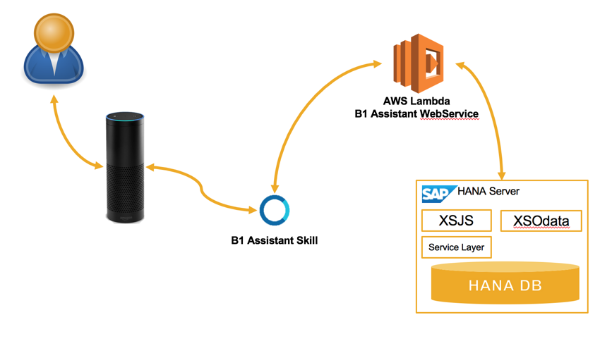
Retire Your Keyboard with SAP Business One and Alexa
B1 Assistant
Refer to this blog and video.
Notes:
Last but not least, refer to this blog on how Amazon Alexa is taking the customer experience on SAP Business One to another level.

